Slide 1
Node.js: time server
Jenish Patel•19549 • 02.09.20X21

Slide 2
Overview
Introduction
Requirement
Implement
Test
Conclusion
References

Slide 3
Introduction
Node.js
Node.js is a platform built on Chrome's JavaScript runtime for easily building fast and scalable network applications. Node.js uses an event-driven, non-blocking I/O model that makes it lightweight and efficient, perfect for data-intensive real-time applications that run across distributed devices.
Features of Node.js
Asynchronous and Event Driven
Very Fast
Single Threaded but Highly Scalable
No Buffering

Slide 4
Requirement
Knowledge
Html
Css
Javascript
Http
Dependency
Node.js
Npm

Slide 5
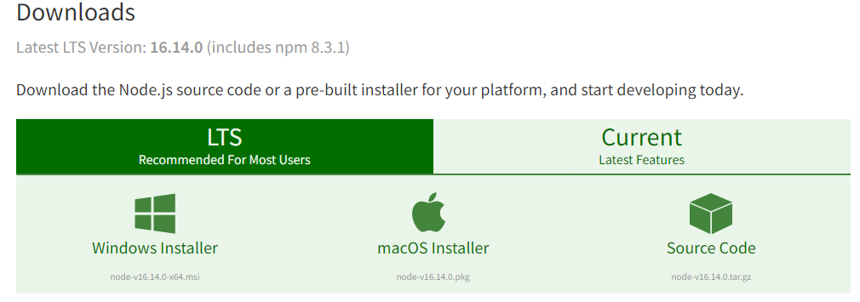
Requirement
Download node.js from https://nodejs.org/en/download/
setup npm
Mkdir <folder name>
Npm install <folder name.
Type npm for acknowledge
Type npm init -y

Slide 6
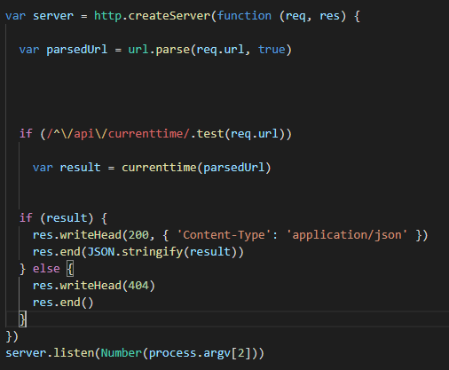
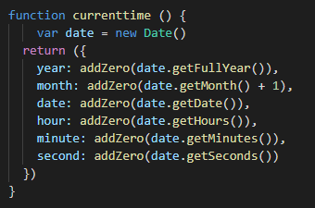
Implement
Get time function
Set server

Slide 7

Next steps
test
Node <file name> <port number>
For exp: node time_server 8000

Slide 8
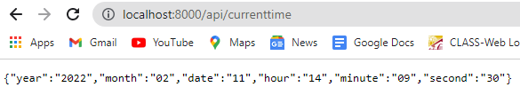
Result
Go to browser and type http://localhost:8000/api/currenttime
Where 8000 is your port number and currenttime is your function

Slide 9
Thank you

